Slide 1
Lecture 8
Catch up from Lecture 7
Structural classification of proteins
Tertiary structure (single polypeptide chain)
  Single fold
  Multifold
  Repeated folds
Quaternary structure (2 or more polypeptide chains)
Lecture 7 Learning Outcomes:
Beta turns
Describe how beta turns are defined (4 amino acid residues, i+1 and i+2 phi,psi torsion angles)
Identify beta turn positions where Pro is favored or where Gly is required
Collagen
      Describe the structure of Collagen (primary, secondary, tertiary, quaternary)
      Describe collagen synthesis (what occurs inside vs. outside the cell)
      Explain link between Vitamin C deficiency and Scurvy
      Identify what amino acid sidechains undergo post-translational modification (hydroxylation, crosslinking) and where (inside vs. outside the cell) these modifications happen.
Protein Folds
List and recognize the main categories of folds (e.g., all alpha, all beta, etc.)
Give reasons for the limited number of unique protein folds.
Describe what a topology diagram shows
Lecture 8 Learning Outcomes:
Define fold, superfamily, family
Describe the purpose of SCOP/SCOPe, what they do and what they provide
Distinguish between a multi-fold tertiary structure vs a quaternary structure (stable or transient)

Slide 2
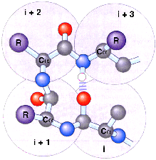
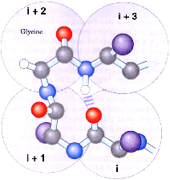
Turns: 4 AA are the minimum for a chain to turn 180º and a type of II structure
“Turns” allow the polypeptide chain to reverse direction.
They are defined by the (i + 1) and (i + 2) Φ,Ψ
Definition: < 7 angstrom between Cα(i) and Cα(i+3)
These four AA do not have repeating Φ,Ψ values!
Names: β-turn, tight turn, reverse turn
Most turns at protein surface. Small proteins ~ 1/4 of all AA in turns.
Are there other secondary structures?!
Various “rules” have been found:
Only Gly
α-helix, β-sheet, and turns
account for only ~ 60% of all AA in proteins!
2 different cases:
C
_{j} Other ~40% not random Φ,Ψ values! Instead, simply not repeating φ,ψ values.
H-bond
Jargon: non repeating Φ,Ψ parts of proteins, i.e. not turns or helices or sheets, are called “coil” or “loop”. These "coils/loops" also make all possible H-bonds.
N
Type I Type II
_{k} Some proteins are “intrinsically disordered”, with parts or even the entire protein not having fixed structure.
Pro common
AA in turns often polar/charged: Why?! At surface, in contact with water
Types I & II most common. Ten types now identified

Slide 3
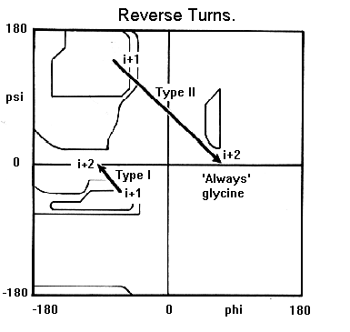
More on turns
~ 25% of turns have no H-bond to stabilize the turn! Many turns are at protein surface where H-bonds are made to water, instead of within the turn.
AA i + 1 and i + 2 define, or “make the turn”, and have particular Φ, Ψ values;
How to read where these turns show up on a Ramachandran map:
➢
Note that the Φ, Ψ values do not repeat for the consecutive i + 1 and i + 2 turn AAs
➢
➢
Φ, Ψ values for i + 1 i + 2
Type I -60º, -30º -90º, 0º
➢
Type II -60º, 120º 80º, 0º

Slide 4

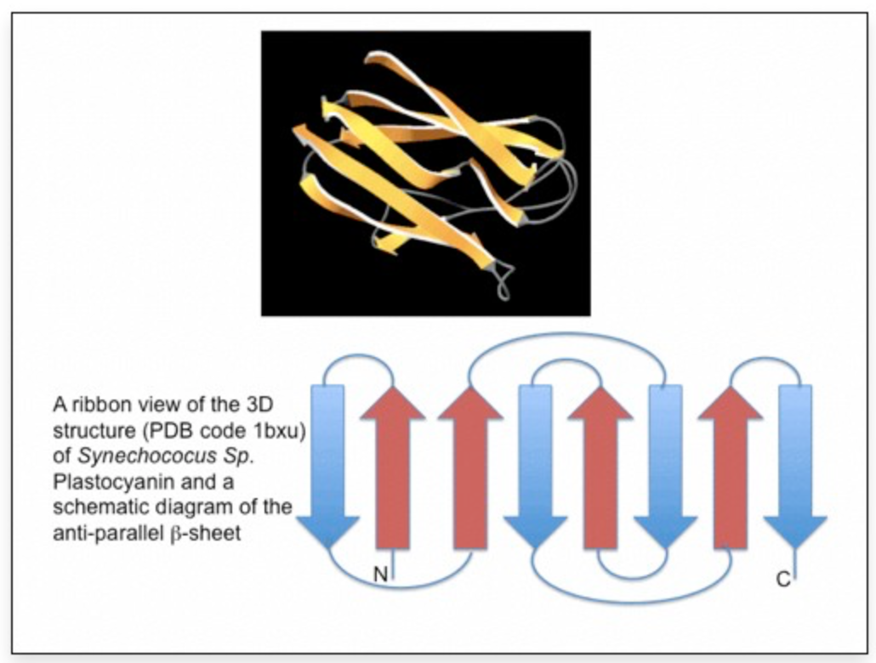
Fold Patterns Drawn in 2D
Topology diagram shows beta-sheet connections
Greek Key Motif (Jane Richardson, Duke U.)
https://proteinstructures.com/Structure/Structure/protein-motifs.html

Slide 5


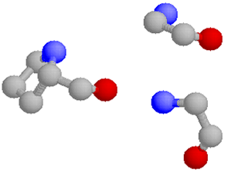
“Special” secondary structure: Collagen
(Gly-Pro-Pro)_{n} = artificial collagen
Repeating Φ, Ψ = -60º, +140º (similar to polyproline type 2 helix!), 3AA/turn
In fish scales, animal hides (skin)
Heat collagen in water:
  Chains come apart and make lots of H-bonds with water gelatin
=
Most abundant protein in mammals! 30% total body protein; found outside of cells: skin, tendon, bone, blood vessels, cornea; a main component of extracellular matrix
Triple helix: tropocollagen
NOT an α-helix!
Only Gly can fit in center of triple helix!
OH
CH
CH₂
CH₂
OH
Pro fits well with Φ, Ψ = -60º, +140º
+
N
CH
CH₂
CH₂
CH
CH₂
NH₃
Many chem. modifications: hydroxy-Pro and hydroxy-Lys; glucose and galactose then added to hydroxy-Lys
“Immature” form of collagen secreted from cells. Outside cell, Lys is oxidized and cross-linked insoluble fiber
Gly NH
Heat collagen dry to 63ºC, chains come apart 1st degree burn (sunburn)
Inside the triple helix

Slide 6
Collagen synthesis and how it gets outside the cell
LUMEN OF SMOOTH ER
Synthesis on ribosomes
SUGARS
Hydroxylation requires ascorbic acid (Vit C). If not Scurvy*
TRANSFER VESICLE
Inside cell
LUMEN OF GOLGI
Sugars added
PROCOLLAGEN
Vesicles of endoplasmic reticulum containing collagen pinch off, fuse with Golgi
Outside cell
SECRETORY VESICLES
Triple helix procollagen forms in Golgi
Vesicles of Golgi containing triple helix pinch off, fuse with plasma membrane
PLASMA MEMBRANE
Outside cell, collagen “trimmed”
Final, crosslinked form of collagen outside the cell
tropocollagen
= COLLAGEN FIBRIL
Outside cell, collagen is “trimmed” by enzyme -catalyzed hydrolysis
Most simple collagen crosslink:
Most simple collagen crosslink:
* Box 4-2 in eBook (Nelson & Cox), “Why Sailors, Explorers and College Students Should Eat Their Fresh Fruits and Vegetables

Slide 7
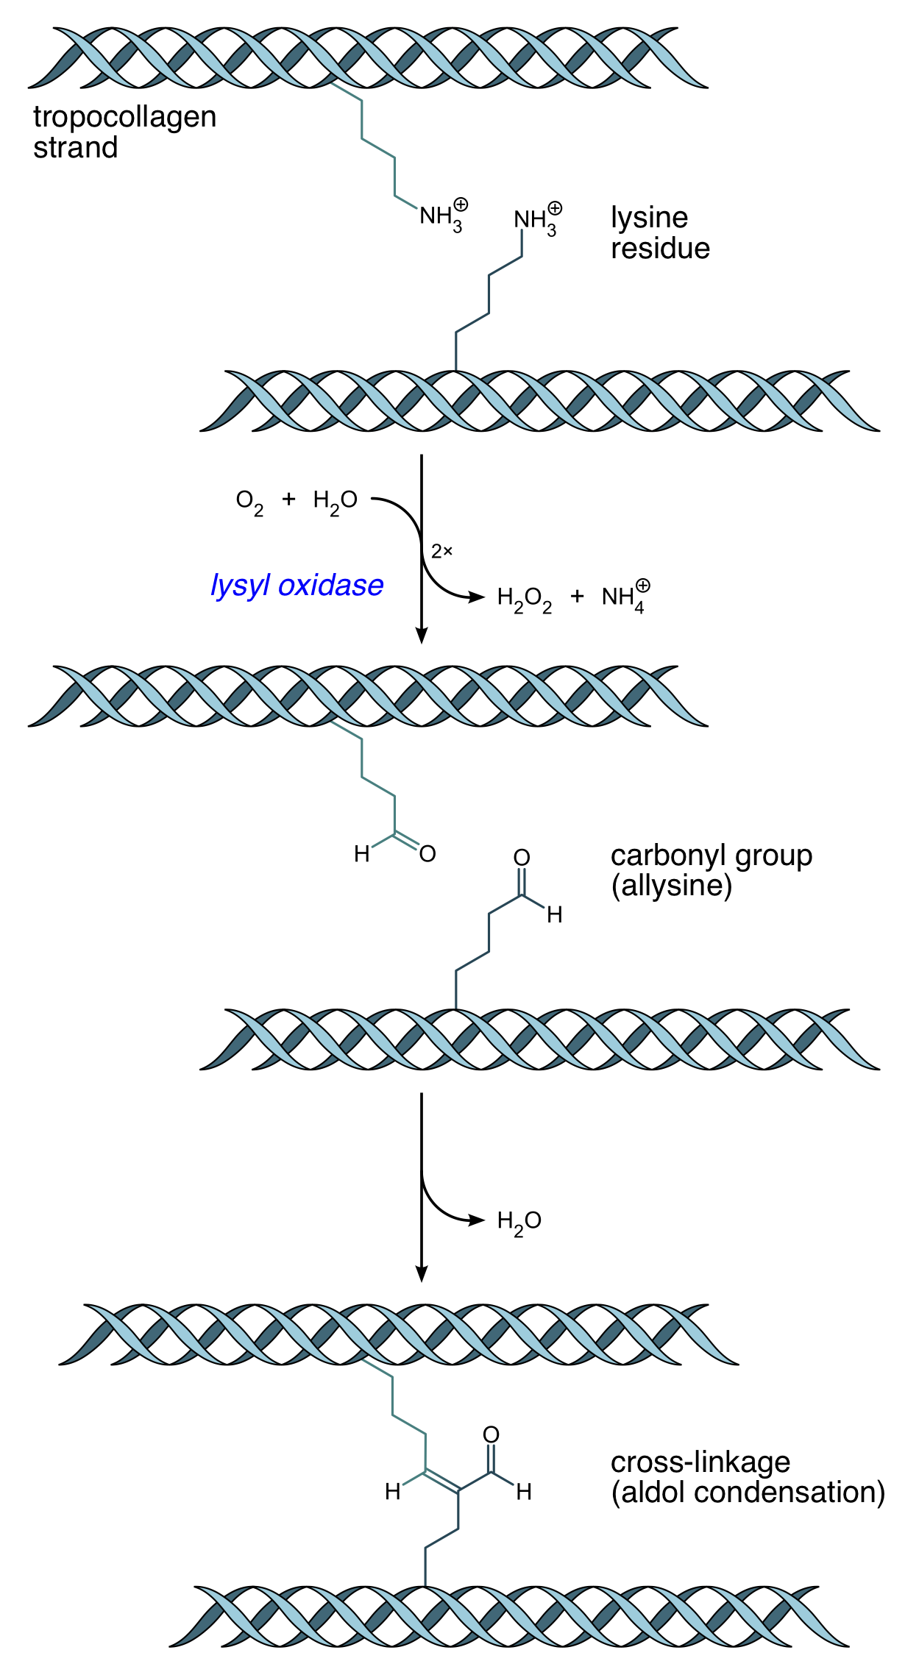
How does this crosslink form?
An enzyme!
→ Hydrogen Peroxide and Ammonium
aldol condensation → water
https://en.wikipedia.org/wiki/Collagen#Chemistry

Slide 8
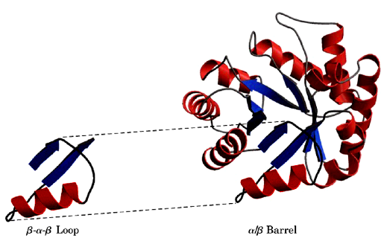
New topic: what is a stable protein fold?
How do α-helices, β-sheets, and turns fit together to form stable structure?
We will mainly use the term “fold” to describe the stable pattern of the protein’s structure
Not very stable by itself; Can unfold in water
A stable fold
Stable folds are also known as: structural domains or motifs or folding units
The word “domain” is used in different ways! Domain can also mean a part of a protein having special binding or function.

Slide 9
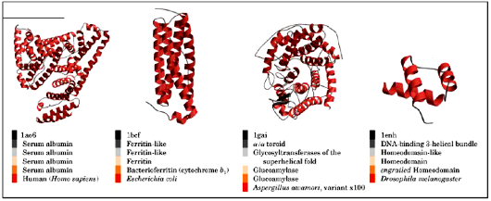
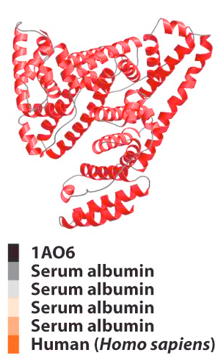
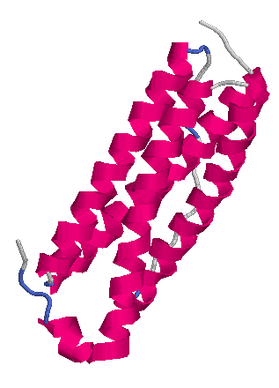
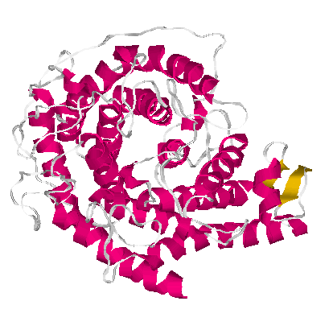

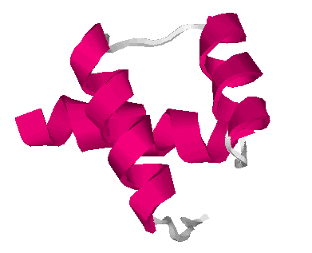
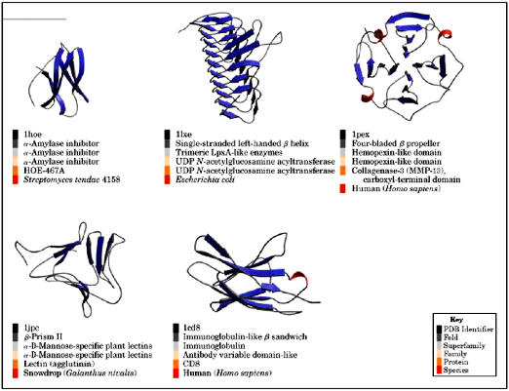
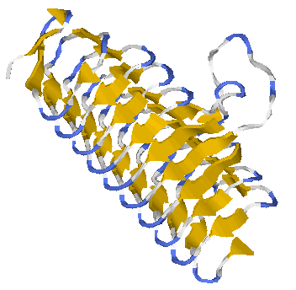
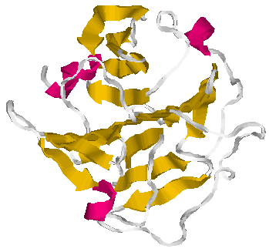
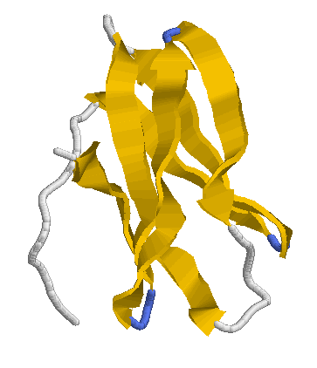
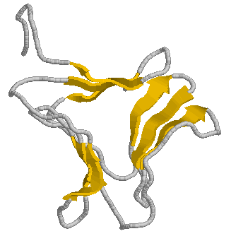
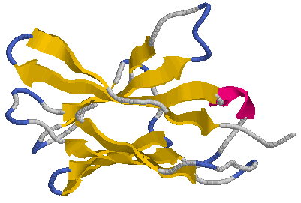
All α
Protein folds
Approx. 1400 identified so far; only “the 20” AA are needed to form all 1400
All β

Slide 10


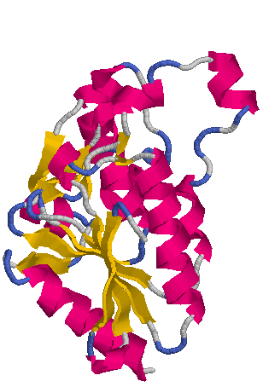


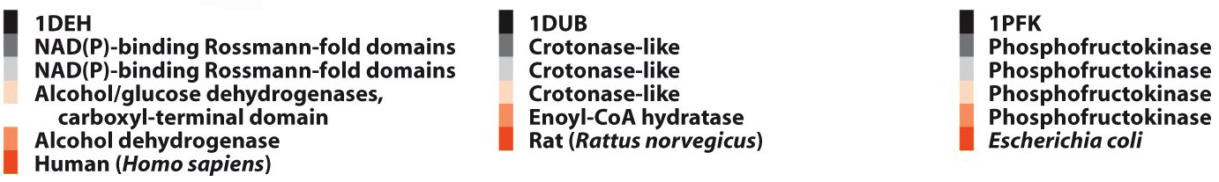


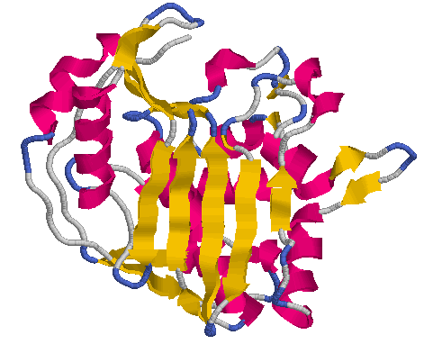
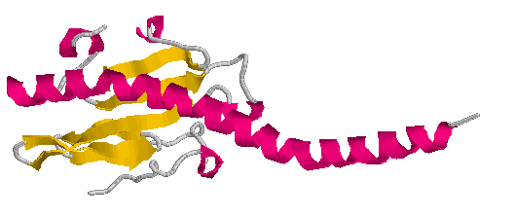
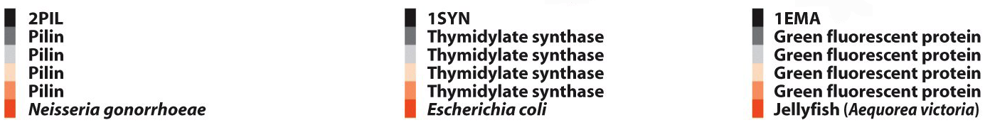
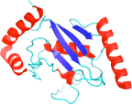

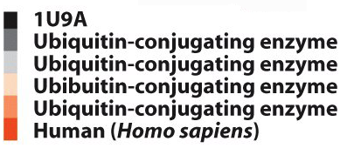
Mixed α AND β

Slide 11
All α
Protein folds
Approx. 1400 identified so far; only “the 20” AA are needed to form all 1400
Maybe not many more different folds exist?!
Why only these 1400?
All β
1. Limited ways to get stable combination of helices, β-sheets, turns, coils
2. That can fold quickly, in millisec to sec or min
3. Another category:
Intrinsically disordered proteins!
Most have large fraction of polar/charged residues, which tend to stay in water rather than to fold

Slide 12
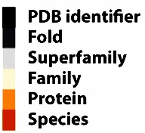
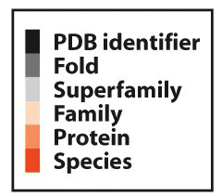
Folds
Mixed α AND β
Several different research groups publish "fold databases"
PDB -- Most up-to-date protein structures, links to SCOP, CATH, etc.
SCOP – Structural Classification of Proteins
CATH – Class, Architecture, Topology, Homology
SCOP classification:
PDB identifier
Fold
Superfamily
Family
Protein
Species

Slide 13
SCOP = Structural Classification of Proteins
http://scop.mrc-lmb.cam.ac.uk
SCOPe = Structural Classification of Proteins extended
http://scop.berkeley.edu
Purpose: The purpose of both SCOP and SCOPe is to “provide a detailed and comprehensive description of the structural and evolutionary relationships between all proteins whose structure is known.”
What they do: look for structural and sequence similarities, classify protein folds (fold, family, superfamily)
How they differ: how they utilize manual curation vs. automated methods (but they agree fairly well)
What they provide: At these websites, you can find an example of every protein fold yet discovered, at
least up to the last update!

Slide 14
Protein classification definitions
From SCOPe = Structural Classification Of Proteins extended scop.berkeley.edu
PDB identifier: protein data bank code
e.g. 1CD8
Fold: also known as structural domain, folding unit, motif. A characteristic arrangement of the major secondary structures, including the same topological connections.
1536 different folds are listed in SCOP
1457 different folds are listed in SCOPe
Immunoglobulin-like β sandwich
These are different folds!
Superfamily: proteins with same fold; vary in AA sequence identity from high to nearly zero. Proteins in the same superfamily have structural (and sometimes functional) similarities that suggest a common evolutionary origin. A superfamily can contain only one, or many different families.
2656 different superfamilies listed in SCOPe
Immunoglobulin
Family: groupings within a superfamily. These proteins have a common evolutionary origin based on either of two criteria: (1) sequence identities of > 30%; or (2) lower sequence identity but having similar structures and functions, for example: globins with sequence identities of ~ 15%.
4919 different families listed in SCOPe
Antibody variable domain-like
Protein: name of this specific protein. Same protein from different species shows a range of amino acid sequence differences.
CD8
Species: the organism in which this protein is found.
Homo sapiens

Slide 15
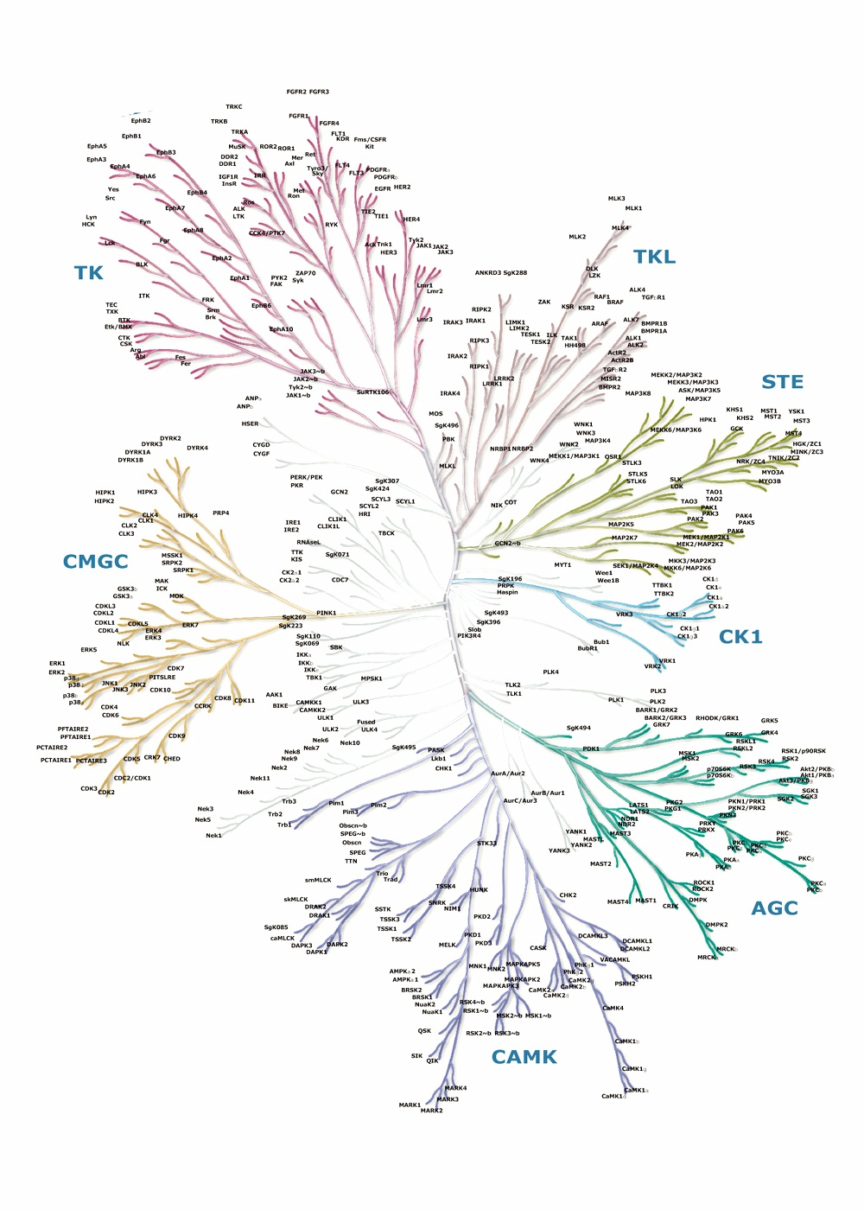
The Human "Kinome" ≡ The kinase superfamily
Let’s clarify the meaning of the protein classifications
=
All catalyze PO₄ chem. mod. of Tyr, Thr, or Ser
Proteins in this superfamily contain same fold: "Protein kinase-like"; All 518 proteins have structural & evolutionary relationship
These proteins differ in small and big ways:
(1) AA differ, so binding sites differ
(2) Additional, different folds added!
Families
TK ≡ Tyrosine is target
TKL ≡ Tyrosine kinase-like
AGC ≡ Includes protein kinase A, protein kinase G, and protein kinase C
The kinase superfamily
Contains 8 families; The proteins within each family are closely related to each other by AA sequence and enzyme behavior
Most kinase proteins evolved to have functions additional to being a kinase.
What does this mean?!

Slide 16
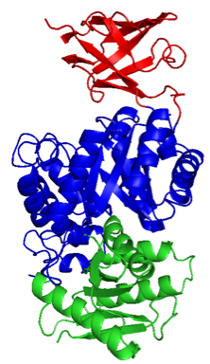

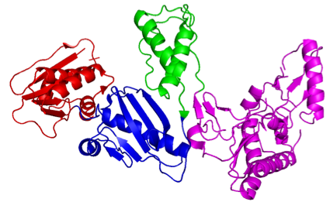




Proteins can have multiple folds within a single polypeptide chain
Pyruvate kinase Has 3 different folds Why: bind pyruvate & ATP, and is regulated
66 kD chain of HIV reverse transcriptase Has 4 different folds Why: Copy viral RNA; syn.DNA; degrade RNA
Has 3 different folds Why: bind pyruvate & ATP, and is regulated
Has 4 different folds Why: Copy viral RNA into dsDNA; degrade RNA
Forms cap over the catalytic site
This is the kinase domain
This is the regulatory domain
All very large proteins: more than one fold
A fold is often a continuous sequence of AA
But: a fold can form from non-continuous AA sequences
Definition: Entire path of a single polypeptide chain, including all folds (and all sidechain conformations), is the tertiary structure, III
Considering all life forms: All 1400 types of individual protein folds are found in all life forms! A major ”tool of evolution" is the combining of folds to make new protein capabilities and complexities.

Slide 17
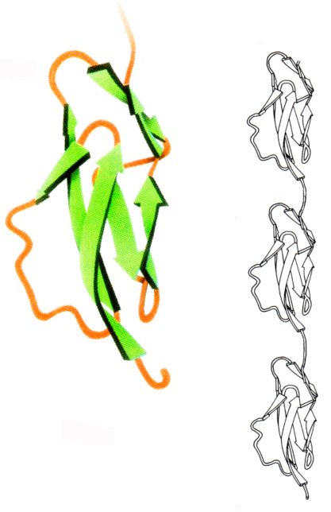
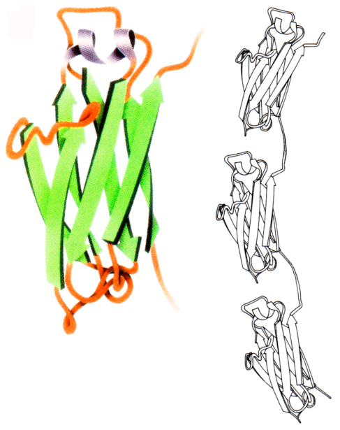
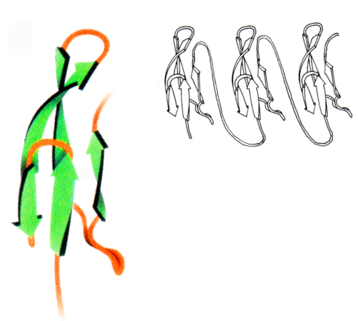
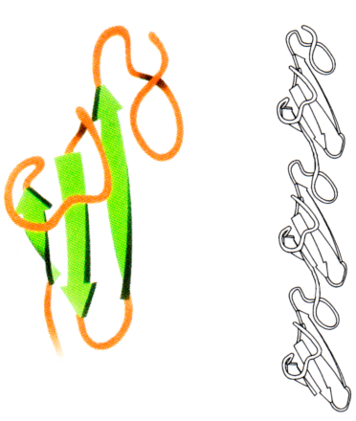
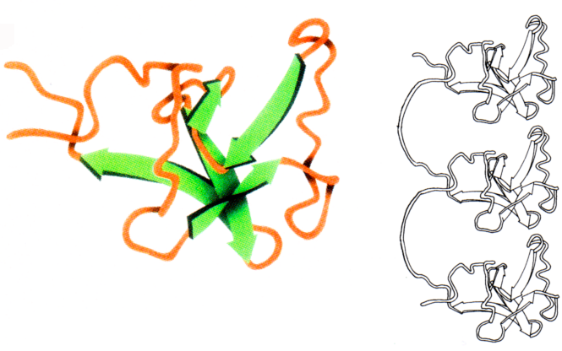
Repeated folds can occur within a single polypeptide chain
Fibronectin Type I fold (F1)
Complement control protein fold (C)
Immunoglobulin fold (I)
Many proteins: polypeptide chain has repeating runs of same fold
Kringle fold (K)
Growth factor fold (G)

Slide 18





Examples of “multi-fold” proteins (schematic pics)
Each a single polypeptide chain
Folds shown:
Fibronectin folds
Fibronectin
These 7 proteins are single chains with some repeated folds – WHY???
Growth factor fold
Interacts with cell surface and extracellular matrix
Kringle fold
Tune specificity and affinity for targets:
Individual repeats may have distinct binding properties
Repeat distance may provide spatial requirement
Target might have multiple recognition motifs!
Complement control protein fold
Immunoglobulin fold
Other parts of the protein
Biomembrane
Fibronectin
Blood clotting factor XII
Blood clotting factors VII, IX, & X
Complement protein 2
N-CAM, a cell adhesion protein
Interleukin-2 receptor protein
Platelet-derived growth factor receptor
4 aqueous proteins
or 3 proteins in the membrane

Slide 19
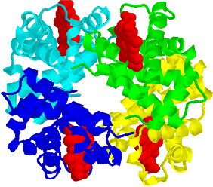
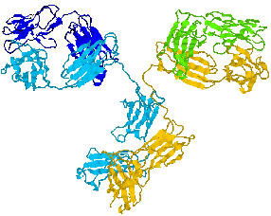
Stable quaternary structure, IV
Jargon: A “subunit” = One polypeptide chain
Definition: IV means having more than one subunit
Immunoglobulin G
4 subunits:
α₂β₂
4 subunits:
H₂L₂
Hemoglobin
Note: Few rules for signifying each subunit! Greek alphabet OK, lower case or UPPER CASE LETTERS OK. But same symbol means same subunit in that protein, e.g. α₂β₂ or a₂b₂ or H₂L₂
In general, what holds chains together in IV?
Good steric and chemical “fit of surfaces”:
Surface nonpolar patches match up Hydrophobic interaction at work!
Ion-pair and H-bond partners match up;
Sometimes, disulfide bonds between subunits
Examples of IV:
Significance of IV:
Typical protein in a cell!
1. Need many components for complex tasks, e.g. ribosome
Ribosome, 30 - 40 subunits
Viruses, can have 100s of subunits
2. IV structure can switch between 2 forms! Key to protein regulation
Muscle filaments, histones, many enz.

Slide 20


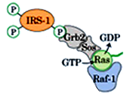



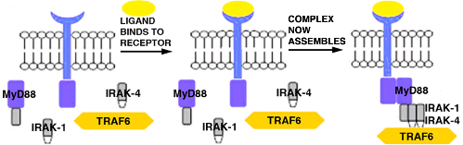
Different IV: Transient quaternary structure
Subunits are called “binding/interaction domains” or "scaffold proteins"
Transient IV structures evolved to "fall apart" when no longer needed!
Jargon: Binding/interaction domains = scaffold proteins: Bind with another molecule, but only when a signal is received, i.e. self-assembled IV structure, but transient.
We do not mean, “an enzyme binding its substrate”
1
This complex of 5 proteins assembles as the 1st step to send “insulin signal”
Raf-1 is mutated in many cancers
Phosphorylation of IRS
Then
Assembly
2
Part of innate immune system; Start of immune or inflammatory response to destroy "invaders"
Complex of 5 proteins assembles as first step to send “asthma signal”
outside of cell
IRAK-1 and IRAK-4: kinases
Cytosolic part of receptor changes
cytosol
Active TRAF6 regulates immune response

Slide 21
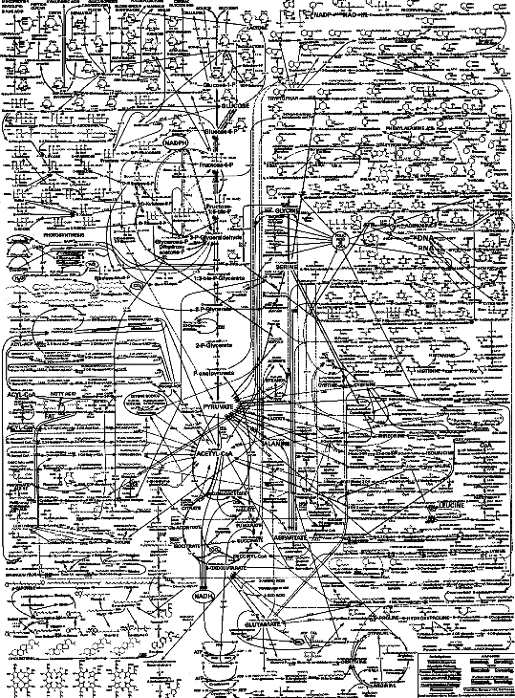
What are these binding/interaction domains all about?!
Interconnections!
~ 5000 reactions in a cell must be coordinated with each other; turned on/off at exactly the right times
Binding/interaction domains (scaffold proteins) are one main way to connect these reactions: xxto each other; xxto "signals”; xxto DNA & RNA

Slide 22








Binding/interaction domains: What do they bind? A few examples
Abbreviated descriptions below of binding specificity and domain symbols/cartoons:
The AA sequences Pro-ANY-ANY-Pro or Arg-ANY-ANY-Lys
Phosphorylated tyrosine
RNA
Phosphorylated serine
The AA sequence, Pro-Pro-ANY-ANY
Each PDZ domain can bind another PDZ domain
A terminal Val or Ile plus preceding 4-5 AA
A phosphate at the 3-position of the headgroup of a membrane phospholipid
But: these domains bind "target" weakly!
Why weakly?! Because: first a signal is transmitted; soon it must disappear, i.e. the IV complex forms, then it must fall apart

Slide 23
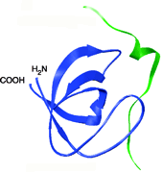

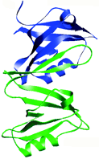

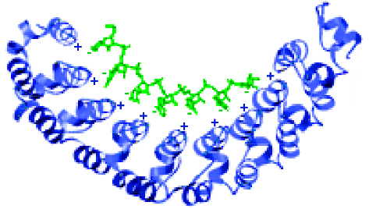

Keep in mind the meaning of the interaction domain cartoons
Cartoon symbol of domain binding to its target:
The more realistic pic of domain binding to its target:
Pro-X-X-Pro
≡
Proline-rich peptide
Csk protein SH3 domain
Syntrophin PDZ domain
(a skeletal muscle protein)
≡
nNOS PDZ domain
A protein that catalyzes syn of NO
RNA
RNA
≡
PUM repeats
Translation repression
A repeated-fold protein!

